Slide 1
Cable Networking Using Kruskal’s Algorithm.

Slide 2

HI!
Team members:
hariharaan s (ra2011003010645)
kalimisetty sashank (ra2011003010649)
mannur vasant reddy (ra2011003010662)

Slide 3
Problem statement:
cable network companies use the Disjoint Set Union data.
To find the shortest path to lay cables across a city or group of cities.

Slide 4
Project Description:
Here we use Kruskal’s algorithm to find the shortest path to lay cables across a city or group of cities.
Which leads us to this post on the properties of Disjoint sets union and minimum spanning tree along with their example.

Slide 5
What are disjoint sets:
A disjoint set is a data structure which keeps track of all elements that are separated by a number of disjoint subsets.
you can also keep a track of the existence of elements in a particular group.
For example there are 6 elements A, B, C, D, E, and F. B, C, and D are connected and E and F are paired together. This gives us 3 subsets that have elements (A), (B, C, D), and (E, F).
Disjoint sets help us quickly determine which elements are connected and close and to unite two components into a single entity.

Slide 6
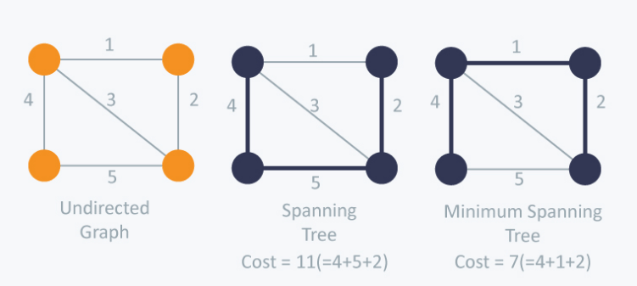
What is Kruskal’s algorithm:
Spanning tree is the sum of weights of all the edges in a tree is known as Kruskal’s algorithm.
A minimum spanning tree (MST) is one which costs the least among all spanning trees.

Slide 7
Algorithm steps:
Remove all loops and parallel edges.
Arrange all the edges on the graph in ascending order. Kruskal’s algorithm considers each group as a tree and applies disjoint sets to check how many of the vertices are part of other trees.
Add edges with least weight; we begin with the edges with least weight/cost. Hence, B, C is connected first considering their edge cost only 1.

Slide 8
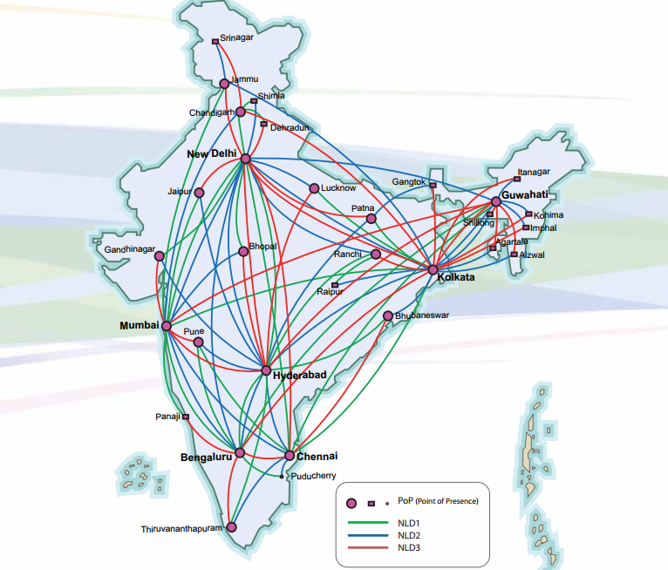
Problem:
Let us consider a map of INDIA.

Slide 9
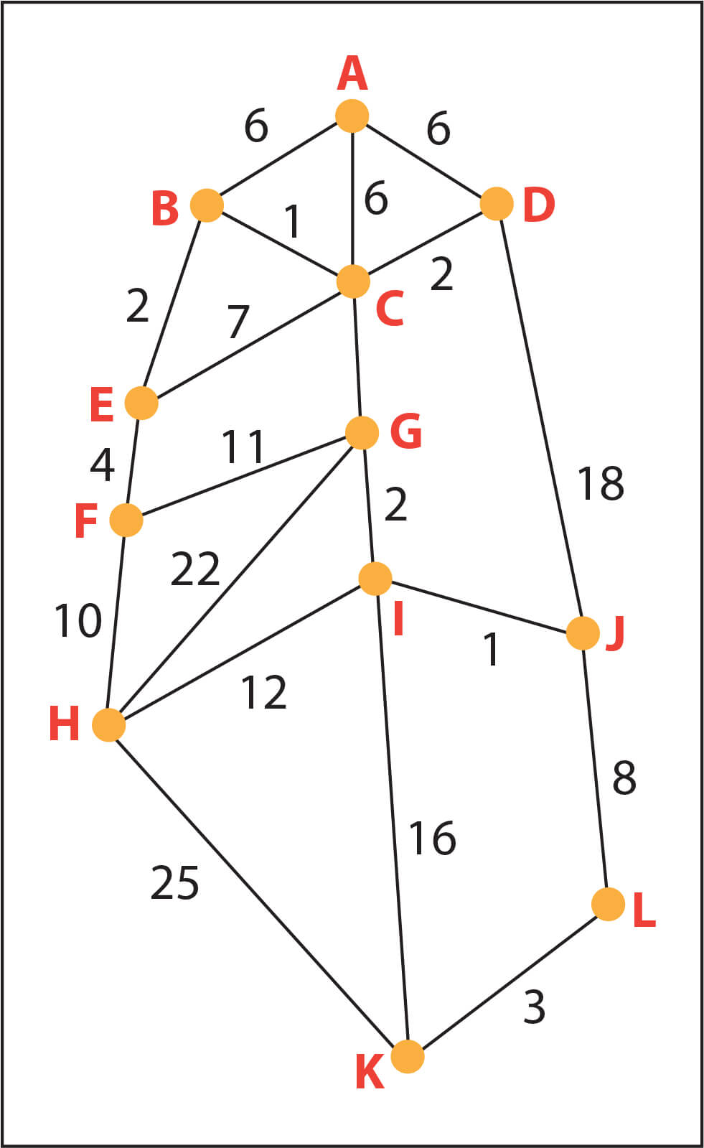
let’s Let’s simplify the map by converting it into a graph as below and naming important locations on the map with letters and distance in meters (x 100).
So for the given map, we have a parallel edge running which is of length 2.4kms(2400mts).
We will remove the parallel road and keep the 1.8km (1800m) length for representation.

Slide 10

Arrange all the edges on the graph in ascending order. Kruskal’s algorithm considers each group as a tree and applies disjoint sets to check how many of the vertices are part of other trees.

Slide 11


